Slide 1
Bike Sharing Demand Prediction pretty 221FA14030

Slide 2
Problem statement :
Currently Rental bikes are introduced in many urban cities for the enhancement of mobility comfort. It is important to make the rental bike available and accessible to the public at the right time as it lessens the waiting time. Eventually, providing the city with a stable supply of rental bikes becomes a major concern. The crucial part is the prediction of bike count required at each hour for the stable supply of rental bikes.

Slide 3
Data set:
Date : year-month-day
Rented Bike count - Count of bikes rented at each hour
Hour - Hour of the day
Temperature-Temperature in Celsius
Humidity - %
Windspeed - m/s
Visibility - 10m
Dew point temperature - Celsius
Solar radiation - MJ/m2
Rainfall - mm
Snowfall - cm
Seasons - Winter, Spring, Summer, Autumn
Holiday - Holiday/No holiday
Functional Day – No Func (Non Functional Hours), Fun(Functional hours)

Slide 4
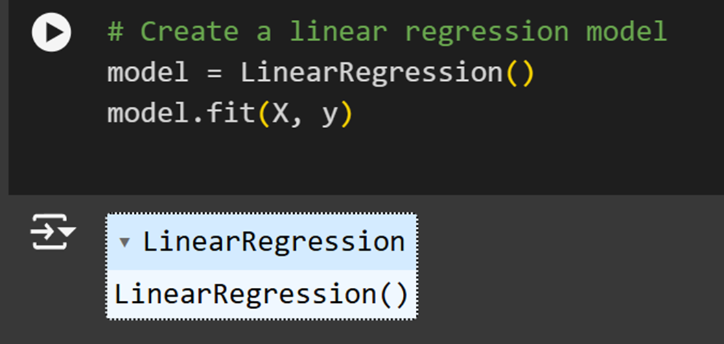
Creating linear regression model

Slide 5
Predicting y values

Slide 6
Plotting the linear Regression graph through by Comparing Temperature and Rented bike count

Slide 7
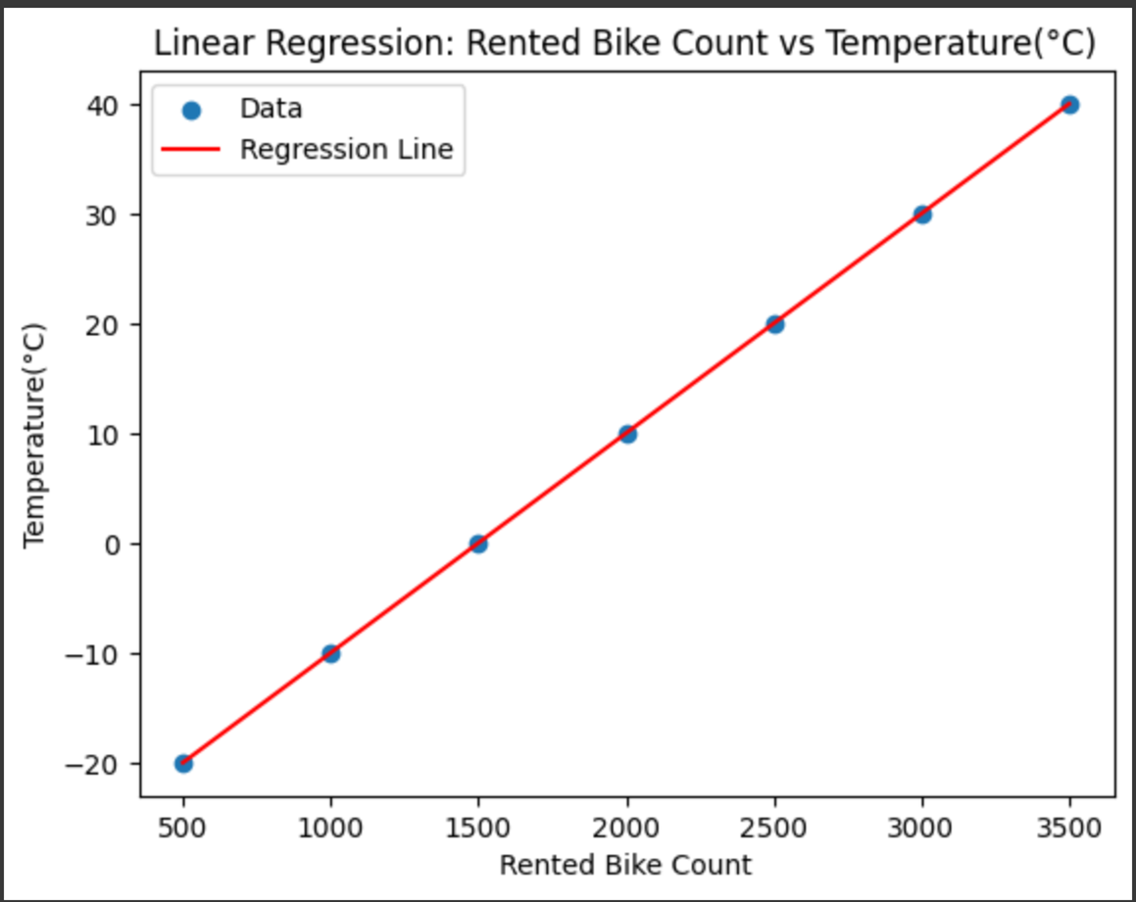

Slide 8
IN R PROGRAMMING
First Install packages in R studio
install. packages("ggplot2")
library(ggplot2)
After installing Library Download Data from Your directory

Slide 9
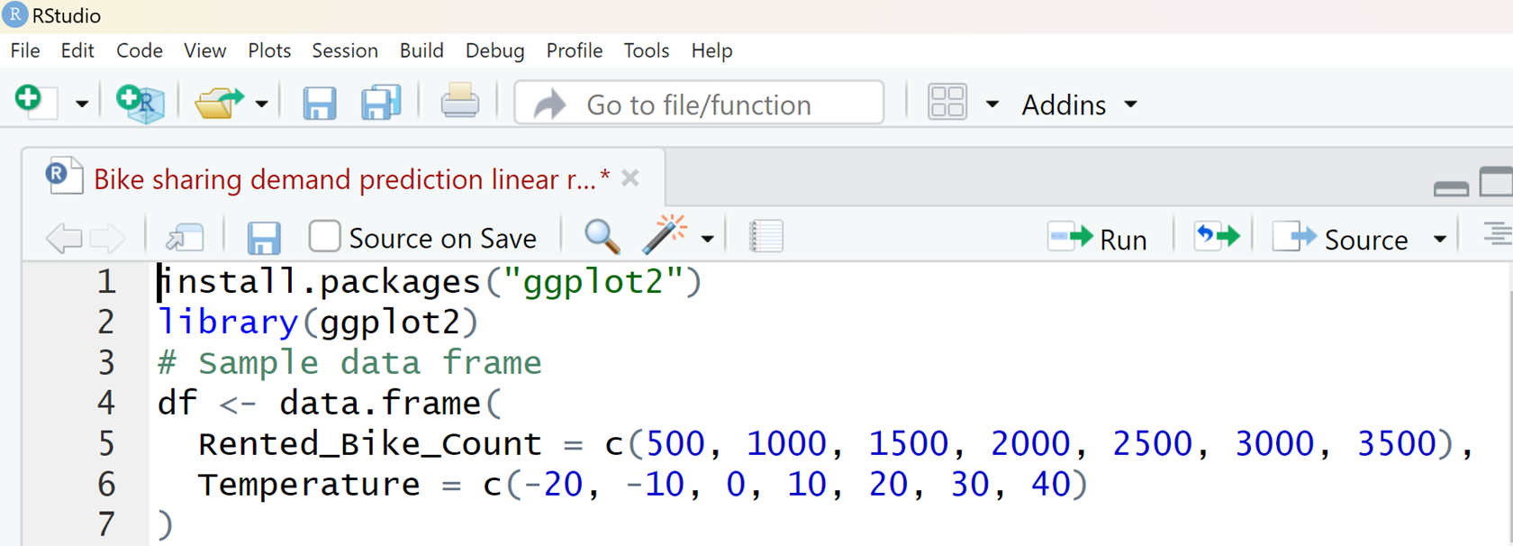

Slide 10
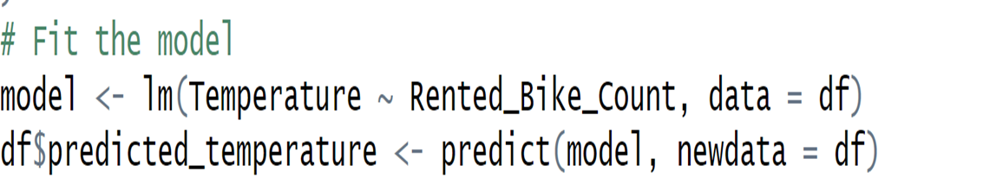
Fit The Model From Your Data and Predicted Data

Slide 11
Plot The Linear Regression With ggplot2
# Plotting with ggplot2
ggplot(df, aes(x = Rented_Bike_Count, y = Temperature)) + geom_point(color = 'blue', size = 3) + # Plot the data points geom_line(aes(y = predicted_temperature), color = 'red', size = 1) + # Add the regression line labs( title = 'Linear Regression: Rented Bike Count vs Temperature',
x = 'Rented Bike Count’,
y = 'Temperature (°C)' ) +
theme_minimal() + # Use a minimal theme for better aesthetics theme( plot .title = element_text(hjust = 0.5),
# Center the title axis. title = element_text(size = 12) # Increase axis title size )

Slide 12
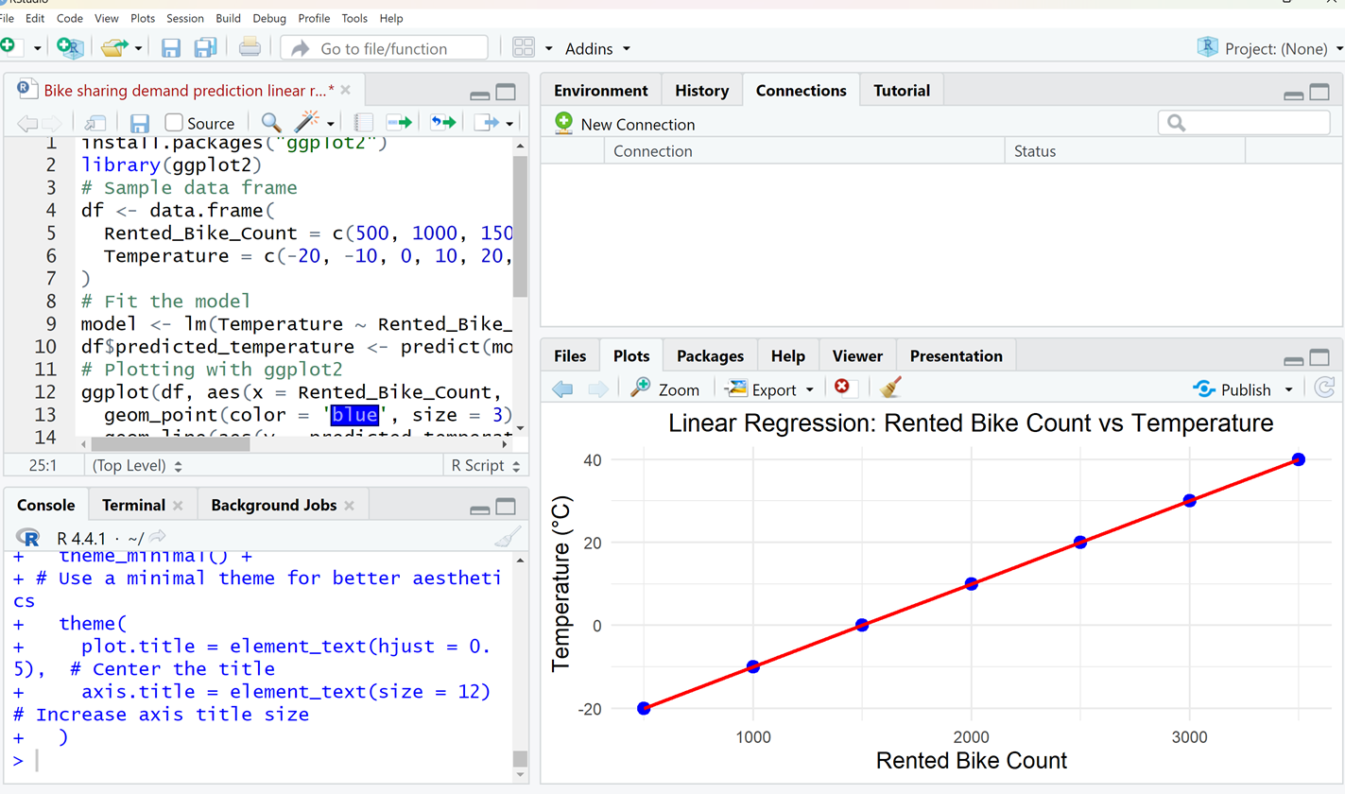

Slide 13
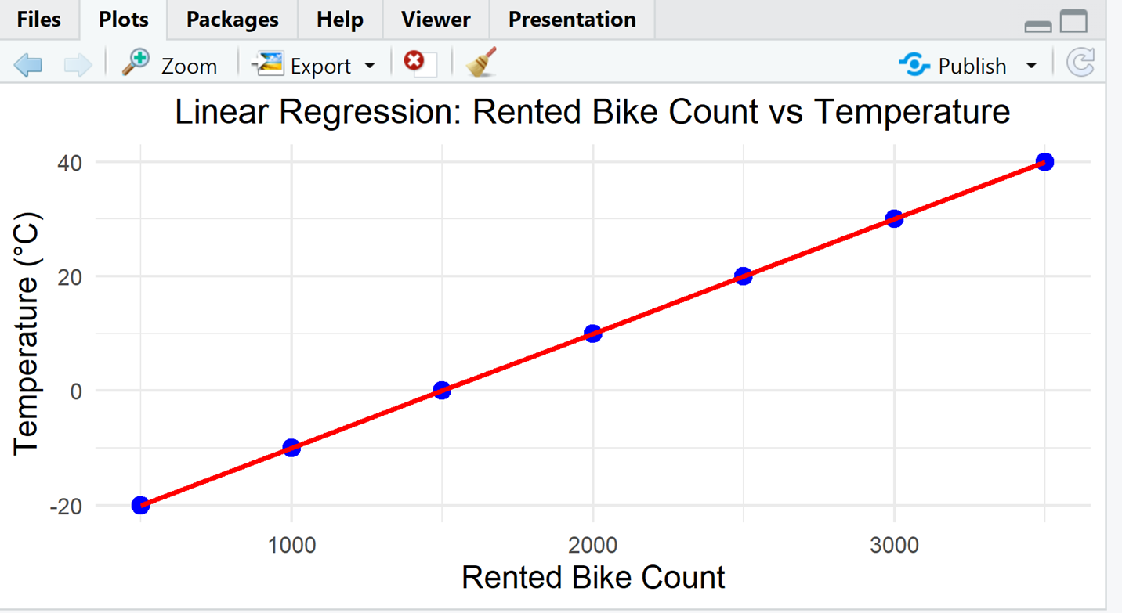
Result Of The Graph in R program

Slide 14
Conclusion
Here We can do Linear Regression of given Data in both R Programming and Python
In Python we can plot the linear Regression graph through python code and in google colab
In the R programming we can plot graph through installing the packages in R studio After installing the library
we can plot the linear Regression graph through our Given Data.

Slide 15
THANK YOU

